Slide 1

Infosys_ElectViz – Election Data Visualization for Media
Transforming complex election data into interactive visual insights for
media professionals and analysts
TEAM MEMBERS
Swayam Bana Sharmika Shri R Vaibhav Pawar Nandhini B Diksha Palliwal Nandini Vakare
Mentor: Mrs. Nithyasri S J

Slide 2

Project Objective
Making Election Trends Accessible to Everyone
Project Description
Analyze large-scale Indian election data using advanced analytics tools
Convert complex datasets into simple, interactive dashboards
Help media professionals and election analysts easily understand election trends
Provide comprehensive insights across Indian elections from 2009 to 2021

Slide 3

Project Execution Milestones
A systematic approach from raw data collection to actionable visual insights, executed through seven key milestones.
Data Collection
1
Gathered comprehensive election datasets from reliable sources, covering multiple years, states, and
candidates across India
Data Cleaning & Preprocessing
2
Removed missing and inconsistent values, standardized party and state names for uniformity Using Power Query Editor
Data Modeling
3
Created relationships between candidates, parties,
states, and election years for seamless
KPI Calculation
analysis
4
Calculated vote share, seats won, voter turnout, and winning margins using DAX in Power BI
Dashboard Development
5
Designed interactive charts with filters and slicers
for dynamic exploration
Insight Generation
6
Identified key trends and patterns through comprehensive data analysis
Testing & Presentation
7
Test and validate all the KPI measures and charts results for better understanding

Slide 4
Overcoming Technical Challenges
Strategic Problem-Solving
We encountered significant challenges with large, complex election datasets containing missing or inconsistent records.
Building accurate relationships and maintaining performance with massive data volumes required careful planning.
Our resolution approach:
Systematic data cleaning and standardization
Proper data modeling in Power BI
Optimized visuals with efficient DAX calculations
Ensured smooth and high-performance dashboards
Cleaning
Optimization
Standardization
Data Modeling

Slide 5
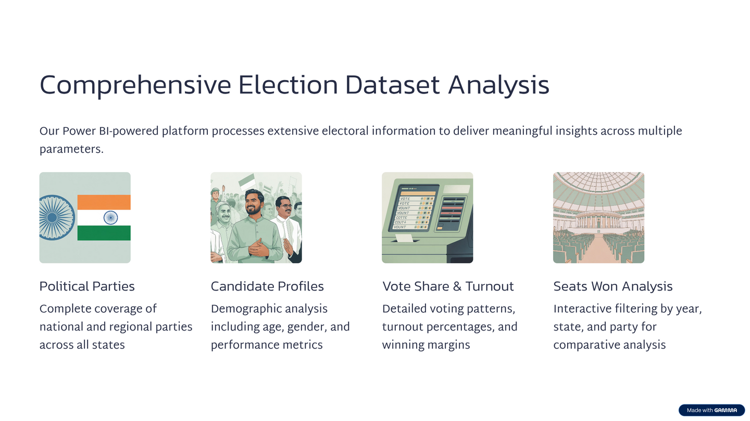
Key Insights

Slide 6
Key Electoral Insights
Our comprehensive analysis uncovers fascinating patterns across India's democratic landscape over 12 years of electoral data.
4K+
91K+
1.53B
Constituencies
Candidates
Total Votes
Complete coverage across India
Participated in elections
Recorded across all elections
Key Findings
  Analysis of significant regional voting patterns and their impact on national results.
  Identification of key swing states and their historical electoral behavior.
  Trends in incumbent performance across various elections and states.
  Dynamics of pre-poll and post-poll coalition formations.
  Variations in state-wise seat distribution and their implications for political power.

Slide 7
Future Enhancement
Expanding capabilities to deliver even more powerful analytical tools for election insights and predictions.
Integration of real-time election data
Addition of predictive analysis using machine learning
Inclusion of more candidate attributes like education and income
Drill-down analysis at constituency level
Deployment through Power BI Service for wider access
Conclusion
The system successfully analyzes election data and presents meaningful insights through interactive dashboards. It enables better decision-making by identifying key trends, patterns, and performance indicators.
The project demonstrates how data visualization tools like Power BI can transform complex electoral data into clear, actionable insights for media and analysts.
Overall, the solution is efficient, scalable, and can be further enhanced with real-time data and predictive analytics.

Slide 8
Acknowledgements and References
We would like to express our heartfelt gratitude to:
Infosys Springboard Team – for organizing this valuable internship opportunity
Our Mentor – for her continuous support and feedback
My Teammates – for collaboration, encouragement, and insights
This internship has been a significant step in our professional growth and technical journey. References:
Election Dataset (Kaggle source)
Microsoft Power BI Documentation
Infosys Springboard Virtual Internship course materials

Slide 9


